Slide 1
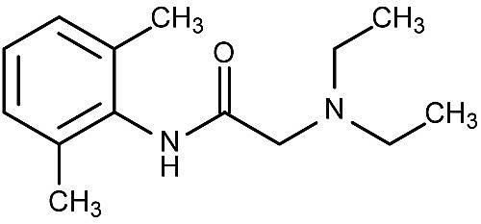
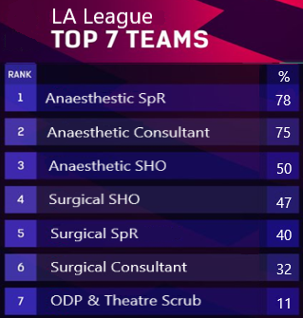
Local Anaesthetics: Does anybody have a clue? A snapshot survey of knowledge of theatre staff Dr H.Griffiths¹, Dr A.Lewinshon¹, Dr YM.Liu^{1,} Miss A. Knight² ¹Anaesthetics, Luton and Dunstable University Hospital, Lewsey Road, Luton, LU4 0DZ ²Breast Surgery, Luton and Dunstable University Hospital, Lewsey Road, Luton, LU4 0DZ
Introduction
Results
Conclusions
Local Anaesthetics (LA) are commonly used by anaesthetists and surgeons for nerve blocks and wound infiltration.
A local incident occurred where a patient unintentionally received a dose of LA which was above the safe recommended dose for their weight.
The team debrief revealed a lack of knowledge regarding safe LA dosing and no discussion took place within the team about correct LA dosing.
The authors set about to determine if this was true in other theatre teams
94 Respondents: Anaesthetists (38), Surgeons (29), ODPs (16), Theatre Scrub (11)
A generalised lack of LA knowledge across all user groups – even the anaesthetists did not score 100%!
Responsibility for LA administration lies with person giving the drug so it would be expected that surgeons should know what the safe dose of LA ought to be.
Collective responsibility within team to all be aware of safe dosing as there is potential to cause patient harm such as seizures, cardiac arrest and death from LA toxicity. TS and ODPs have a role to play in preventing accidental over administration of LA.
The team brief should be used to facilitate discussion about correct LA dosing before the case.
Aim to create a ‘cheat sheet’ for display within theatres which all team members can refer to when contemplating LA use.
Likely that the results from this snapshot survey would be reflective in other Trusts which would pose a potential patient safety issue.
This survey demonstrates that when it comes to LA administration, nobody really has a clue.
What is the recommended maximum dose (in mg/kg) for plain bupivacaine?
How much local anaesthetic is there per ml in 0.5% bupivacaine?
% Correct
A 89kg female needs local infiltration of her operative wound. What is the maximum dose of lignocaine 2% (without adrenaline) she can receive?
Methods
Following audit department approval, an online questionnaire was created using SurveyPlanet©. The questions were centred around commonly used LAs and clinical scenarios.
A prospective snapshot of staff in different clinical areas over 5 days took place.
All surgical specialties including obstetricians & maxillofacial surgery were surveyed as well as allied health staff such as theatre scrub (TS) and operating department practitioners (ODPs).
The answers to the questions were referenced against RCOA Guidance.¹
% Correct
LA League table showing average marks scored in the survey
In addition to the above 3 questions others included:
What is the recommended maximum/safe dose (in mg/kg) for lignocaine with adrenaline?
How much drug is there per ml in 1 in 1000 adrenaline?
A 42kg man needs local infiltration for a large laparotomy wound. What is the maximum volume of 0.25% levobupivacaine he can receive?
References
1. Basic Anaesthetic Drugs https://www.rcoa.ac.uk/sites/default/files/documents/2019-11/ANAESTHETIC_DRUG_CRIB_SHEET-8.pdf

